Slide 1
SI 370 Final Project
NFL Draft Data Analysis

Slide 2
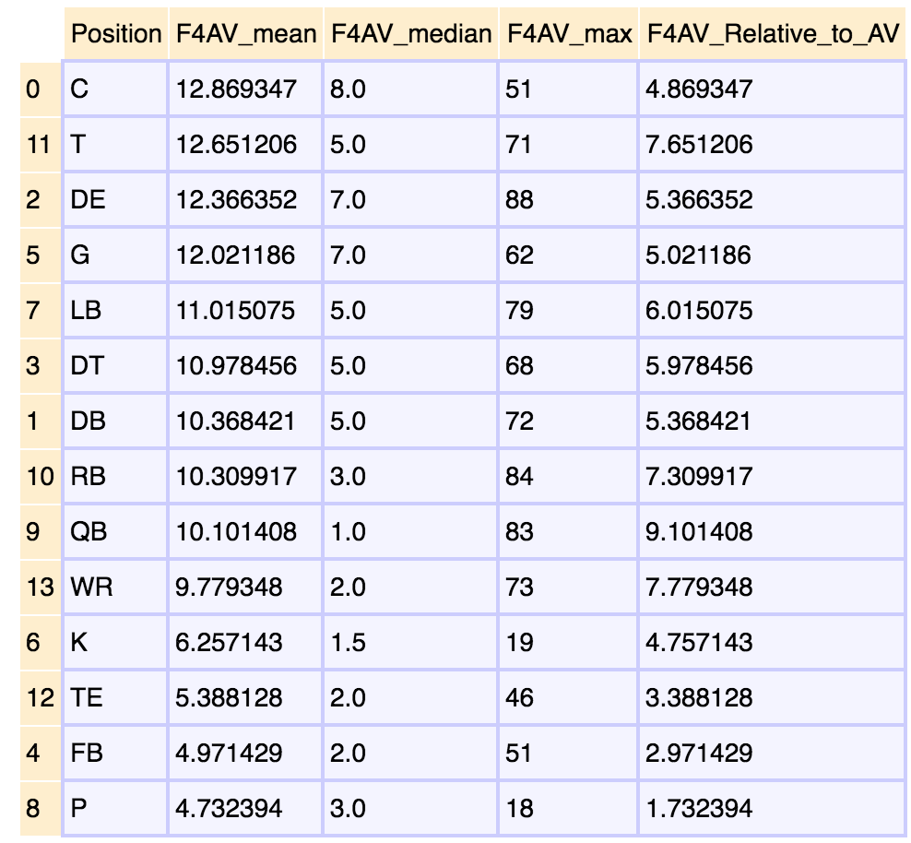
Initial Analysis
Measure : First4AV
F4AV_Relative_to_AV
Mean – Median
Issues
Bad measure
QB’s
Largest difference
Created new scoring system

Slide 3
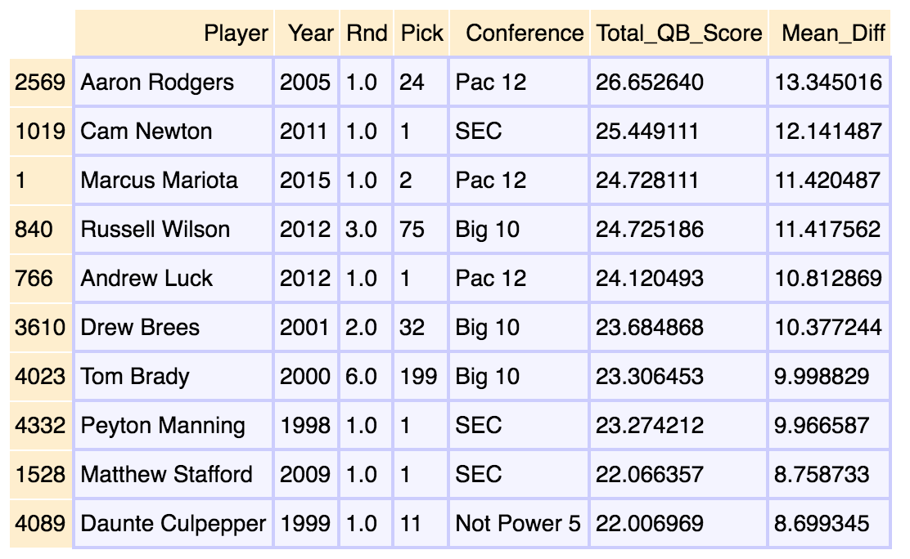
New Scoring System
Total_QB_Score
Multiply average completion percentage by 10
Multiply average touchdowns/game by 6
Multiply average passing yards/game by 0.025
Multiply average run or receiving yards/game by 0.10
multiply average interceptions per game by -4

Slide 4
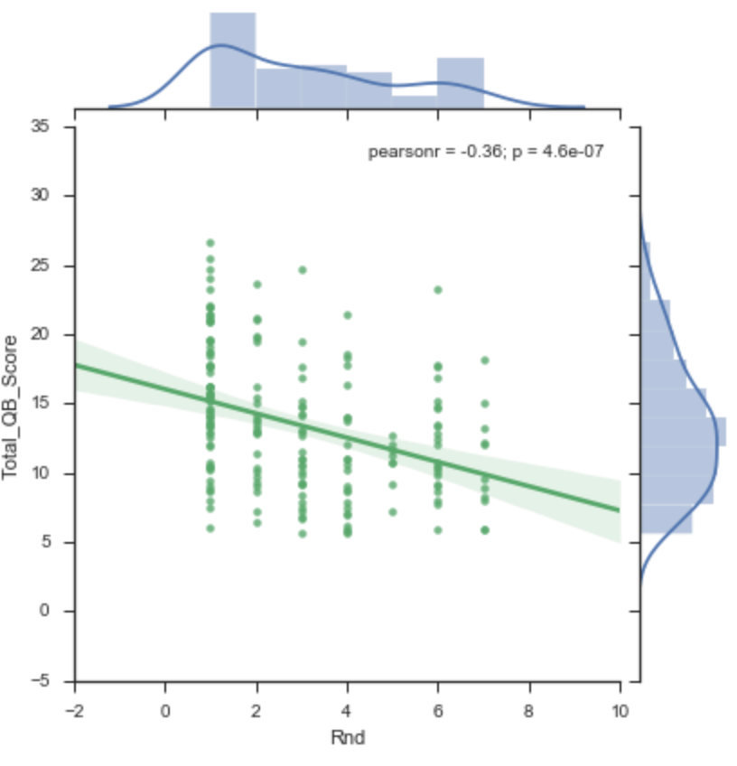
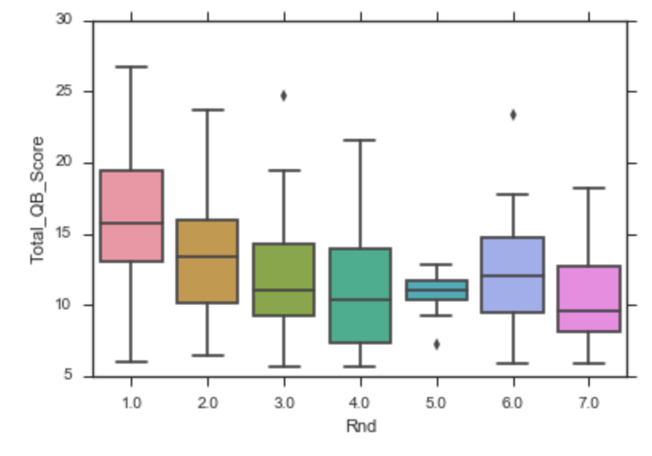
Total QB Score & Round Drafted

Slide 5
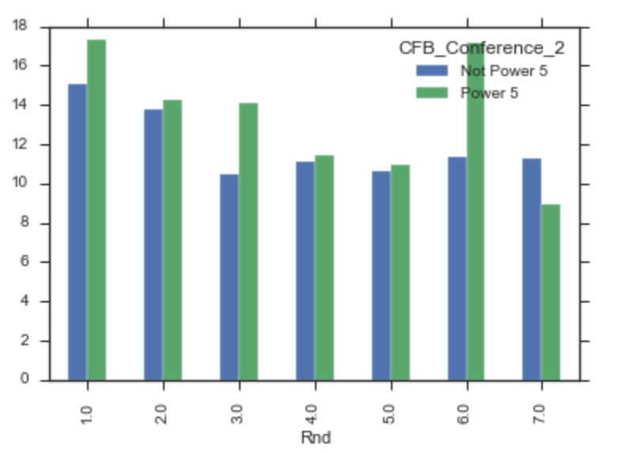
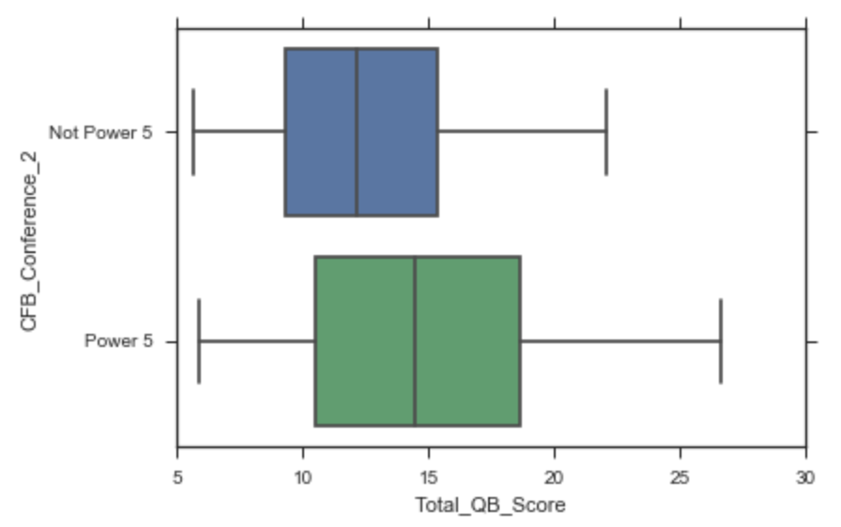
Total QB Score & Conference
Power 5 Conferences: Big 10, Big 12, PAC 12, SEC, ACC

Slide 6
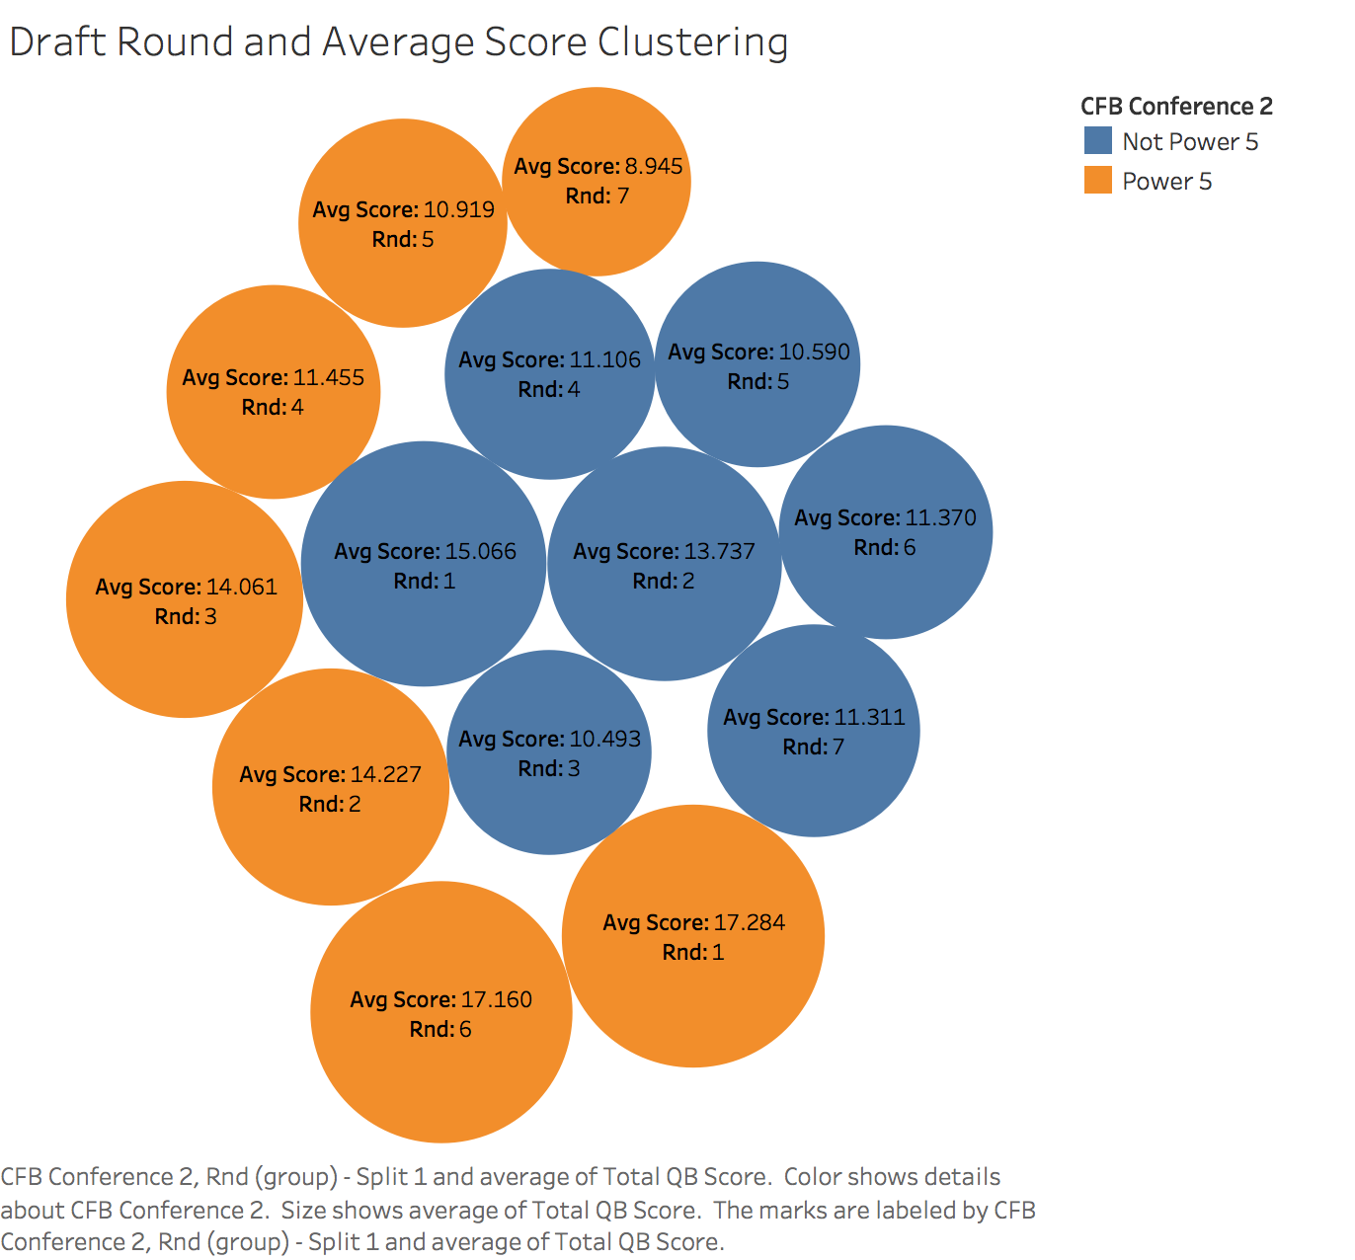
Additional Representation
Outlier: Tom Brady drafted in round 6

Slide 7
Future Analysis
Use API to pull player’s salaries and compare top ranked QB’s and salaries
Do additional data analysis on RB’s and WR’s to compare to QB data

